Slide 1
Compiler Construction Principles and Practice
How do computers understand and execute high-level languages?

Slide 2
Chapter 4 Lexical analysis
※ A lexical analyzer is also called a scanner, with two tasks:
(1) To recognize lexemes
  —— Separate lexemes from source programs;
(2) To translate lexemes
  —— Transform the lexemes to corresponding tokens.
【Summary】
  4.1 Introduction to lexical analysis
  4.2 Design to lexical analyzers
  4.3 Design to arithmetic constant processor
Notes:
把单词转换成机内表示，便于后续处理。
算术常数处理机

Slide 3
4.1 Introduction to lexical analysis
4.1.1 Classification of lexemes
According to the syntax function of lexemes, lexemes can be classified to:
  Identifier —— The name for variables;
  Constant —— Display as their form;
  Special symbols ——
  (1) Keywords —— It is predefined by system, used
  to distinguish syntactic unit.
  (2) Delimiter ——
    Single words —— + - * / , ; : = < …
    Double words—— <= <> >= == /* */ …
Notes:
系统内部定义，具有固定的意义， 通常用来区分语法单元；

Slide 4
4.1 Introduction to lexical analysis
  4.1.1 Recognization of lexemes
  (1) Begin with letter —— keywords or identifiers.
  (2) Begin with digit —— numerical constants.
  (3) Begin with ‘ or “ —— character constants or
  string constants;
  (4) Others —— display as their form, e.g. +, :=, …
  ※ How to distinguish keywords and identifiers?
  If keywords are reserved–not used as identifiers – we can initialize the keyword-table with all the keywords.
  Then, a string is recognized as an identifier only if it is not already in the keyword-table as a keyword.
Notes:
字符型常量或字符串常量；
多数以自身形态识别之，如
现在，大多数编译程序使用“保留字”，即关键字不能用作标识符。系统预先造好关键字表，拼好的字符串，先查“关键字”表，查到了，视为关键字，否则，视为标识符。

Slide 5
4.1.2 Tokens
4.1 Introduction to lexical analysis
The lexemes in languages have different types and different length, and with Token we can achieve:
① come to the same length;
  ② separate syntax and semantic information.
  Presently, we use the following type of Token:
Token:
type | value
Semantic information, e.g. array dimension, upper and lower bounds and types.
Syntax information, e.g. types of lexemes.
Notes:
语法、语义信息分开。
语义信息，如：数组维数，上下界，类型等；

Slide 6
4.1 Introduction to lexical analysis
※ A design scheme of TOKEN:
·Identifier： TOKEN: IT[i] Symbol table
·Constant： TOKEN: CT[c] Constant table
·Keyword： TOKEN: KT[k] Keyword table
·Delimiter： TOKEN: PT[p] Delimiter table
i ·
name…
c ·
123
k ·
Begin
p ·
<=

Slide 7
4.2 Design to lexical analyzers
4.2.1 Lexical analyzers can be divided into two
types
  (1) A single scanner
  Source program Token sequence
（String） （Lexemes）
Scanner
  (2) A subprogram invoked by syntax analyzers
Syntax analyzer
  Token sequence
(after syntax analyzer）
command
Token
getword
Source
program
Scanner
Notes:
作为独立一遍的扫描器
作为语法分析器的子程序的扫描器

Slide 8
4.2.2 Implementation of a simple lexical analyzer
Token sequence
(lexemes)
Translator
Source program
(string)
Recognizer
(1) Recognizer --- A finite automata for recognizing lexemes;
(2) Translator --- Translate the lexemes string to Tokens.
NEXT：A simple recognizer.
Notes:
根据有限自动机所识别出的对象，完成从单词串到单词的TOKEN串的翻译。

Slide 9
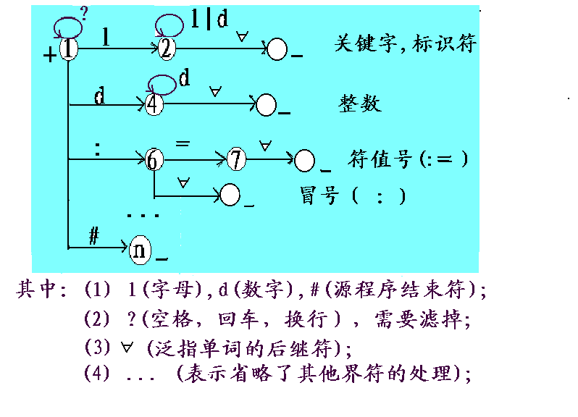
※ A simple recognizer
赋
NEXT：A simple lexical analyzer

Slide 10
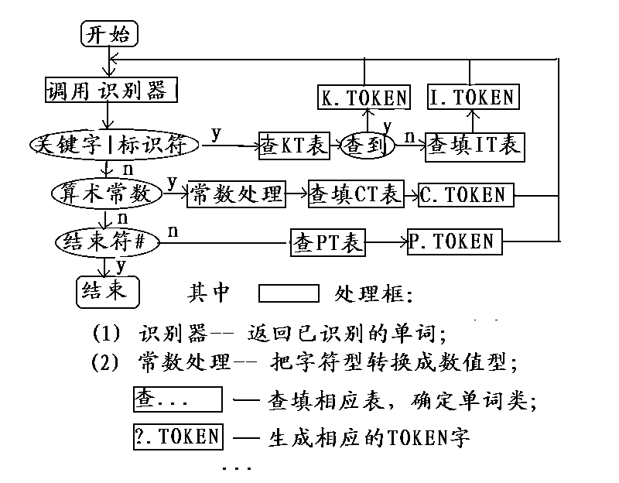
※ A simple lexical analyzer

Slide 11
4.2.3 The result for lexical analyzer
【Example 4.1】A Pascal segment
…
x1:=x1+1;
begin
yy:=5;
zz:=yy*x1;
end;
while (x1=20) do x1:=yy;
…

Slide 12
4.2.3 The result for lexical analyzer
Keyword table
Delimiter table
Symbol table
Constant table
KT[k]
begin
end
while
do
…
PT[p]
:=
;
+
*
(
IT[i]
x1
yy
zz
CT[c]
1
5
20
1
2
3
4
1
2
3
4
5
1
2
3
4
1
2
3
4
6
7
)
=
…
【Note】(1) KT[k]，PT[p] – static table;
(2) IT[i]， CT[c] – dynamic table.

Slide 13
4.2.3 The result for lexical analyzer
x1
:=
x1
+
1
;
begin
yy
:=
5
;
zz:=yy*x1;end; while (x1=20) do x1:=yy;…
The Token sequence from scanner:
(i,i₁)
,
(p,p₁)
(p,p₂)
，
，
(i,i₁)
，
(p,p₃)
，
(c,c₁)
，
(k,k₁)
，
(i,i₂)
，
(p,p₁)
，
(c,c₂)
，
(p,p₂)
，
(i,i₃),(p,p₁),(i,i₂),(p,p₄),(i,i₁)(p,p₂),(k,k₂), (p,p₂), (k,k₃),(p,p₅),(i,i₁),(p,p₇),(c,c₃),(p,p₆),(k,k₄), (i,i₁), (p,p₁),(i,i₂),(p,p₂) .

Slide 14
4.3 Design to arithmetic constant processor
The automata with translating function is called processor, including two parts:
(1) Recognizer(finite automato) as main program;
(2) Translator: insert a translator in the node of automata.
The function of arithmetic constant processor:
4.3.1 Recognizer
· Basic form of arithmetic constant:
String => Numerical value
dd…d.dd…d e(+|-)dd…d；
Mantissa(尾数)
exponent
Notes:
识别器（有限自动机主机）
翻译器（在自动机的状态节点处，插入翻译子程序）
算术常数处理机的功能：

Slide 15
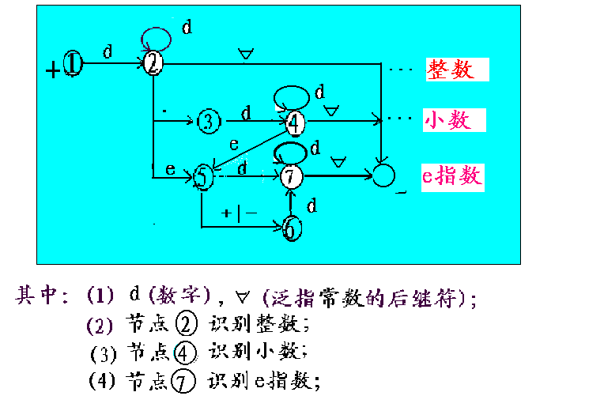
※ A recognizer for arithmetic constant

Slide 16
4.3.2 Translator
1. Algorithm: parameters as follows
Transform symbol to numerical value
Initial values:
n=p=m=t=0; e=1
n：拼尾数值变量；
每当读入尾数数字d时： n = 10*n+val(d);
p：拼指数值变量；
每当读入指数数字d时： p = 10*p+val(d);
m：小数位数变量；
读到小数点 . 后，每当读入小数数字d时： m=m+1;
e：指数的符号变量（+为1，-为-1）;
t：类型变量（整型为0，实型为1）;
Result:
num= n*10^{e*p-m}
Notes:
字符转数值函数

Slide 17
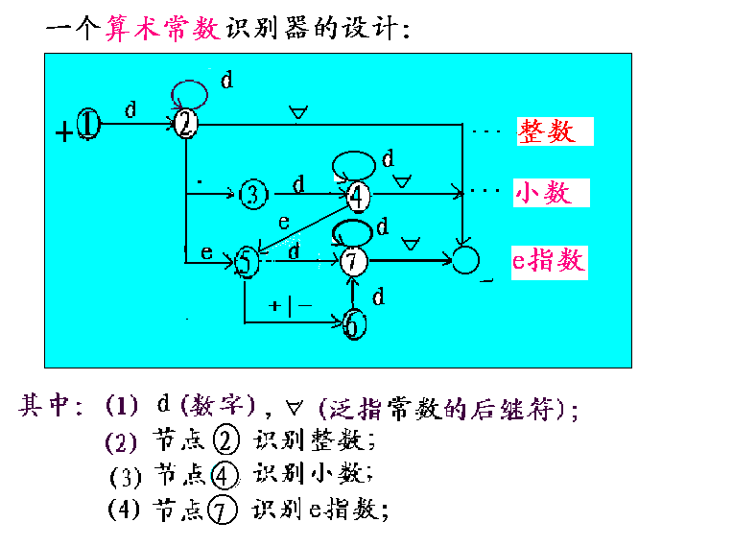
4.3.2 Translator
2. The function in every node:
q₁：Initialization, n=p=m=t=0；e=1；num=0；q₂：n=10*n+val(d)；
q₃：t=1;
q₄：n=10*n+val(d)；m=m+1；
q₅：t=1;
q₆：if ‘-’ then e = -1；
q₇：p=10*p+val(d)；
Notes:
状态节点处(翻译)动作函数设计：
设：在状态i节点处的语义动作为q_{i}；

Slide 18
※常数处理机程序框图：
开始
The flow chart for constant processor
Execute translator
state = 1
Semfun(state)
getchar(ch)
查变换表： δ(state,ch)= ?
y
δ=empty
state = δ
n
reject
n
δ=ok
y
Result: num= n*10^{e*P-m}
Translating result
结束

Slide 19
※ Examples
  Translating process of constant 8.67e-12# :
状态
翻译
n
m
p
e
t
符号
变换
1
q(1)
0
0
0
1
0
8
2
2
q(2)
8
0
0
1
0
·
3
3
q(3)
8
0
0
1
1
6
4
4
q(4)
86
1
0
1
1
7
4
4
q(4)
867
2
0
1
1
e
5
5
q(5)
867
2
0
1
1
-
6
6
q(6)
867
2
0
-1
1
1
7
7
q(7)
867
2
1
-1
1
2
7
7
q(7)
867
2
12
-1
1
#
ok
【Result】 num=n*10^{e*p-m}=867*10^{-1*12-2}=867*10⁻¹⁴

Slide 20
Chapter 4 Lexical analysis
Any questions?

